Slide 1
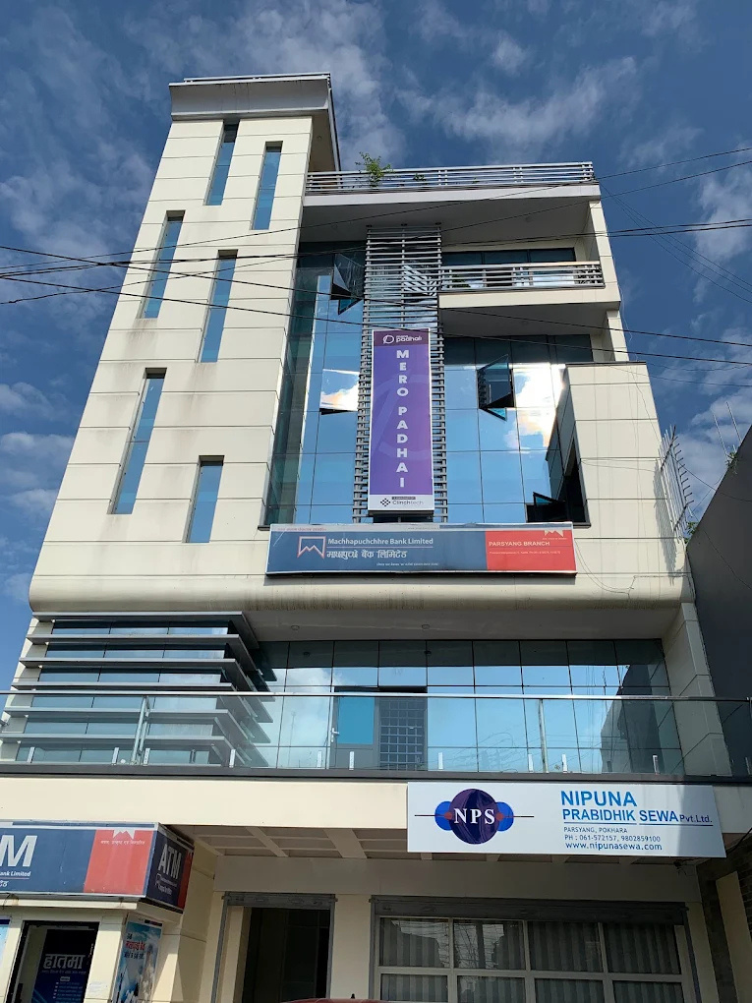


Internship
Presentation
www.nipunasewa.com
Nipuna Prabidhik Sewa

Slide 2
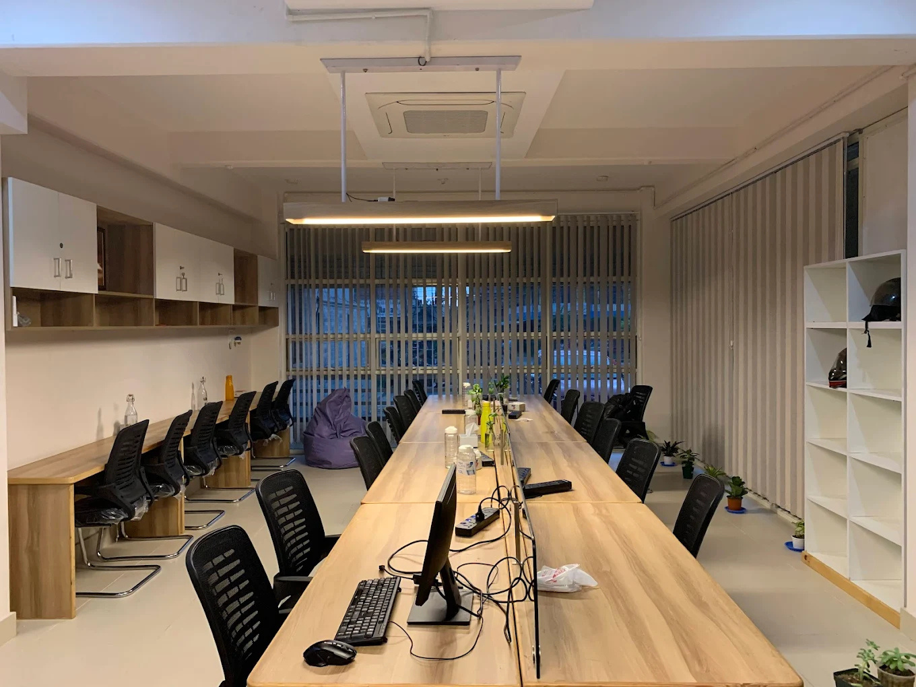

Introduction
Nipuna Prabidhik Sewa Pvt. Ltd. is a technology service provider based in Pokhara, Nepal, established in 2017. The company offers a range of IT solutions including web and mobile application development, cloud services, AI-powered systems, and waste management platforms. With a dedicated team and a focus on innovation, Nipuna is also registered in the U.S. as Nipuna LLC. It emphasizes client-centric services and follows agile development practices to deliver efficient and scalable software solutions.

Slide 3





Roles and Durations
During my internship, I worked as a Backend Developer Intern. My main responsibilities included designing and developing RESTful APIs using the Laravel framework, integrating third-party services, and managing database systems using MySQL.
01
02
03
04
Duration:
Role
Responsibilities
Focus Areas:
Although the BIM program requires a 3-month internship, I chose to complete a 5-month internship at Nipuna Prabidhik Sewa
During my internship, I worked as a Backend Developer Intern.
ncluded designing and developing RESTful APIs using the Laravel framework, integrating third-party services, and managing database systems using MySQL
Laravel Framework:
RESTfull apis
Database Management

Slide 4


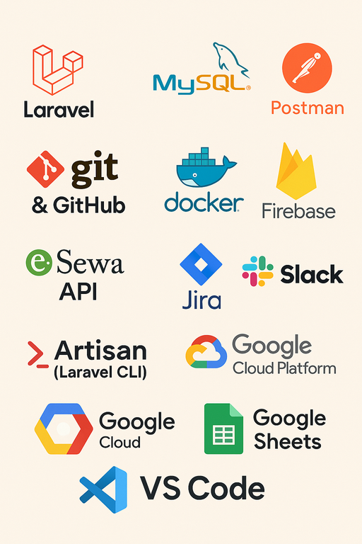


Tools & Technologies Used
Software development
Laravel Framewokrk
Jira
Other
Used for creating consistent development envrioments across different machines and platforms
A php framework used for building robust and scalable backend system
A project management tool used to track task,bugs and project progress ensuring efficient project co-ordination
Postman,Firebase,Github,Slack,Google sheets mysql etc

Slide 5


Developed RESTful APIs
Activities Performed
Integrated third-party services (eSewa, Firebase)
Debugging and testing with Postman
Database design and optimization
Task tracking with Jira, communication via Slack

Slide 6
Limited frontend exposure
Challenges & Limitations
Time constraints for deep exploration
Minimal access to high-level decision making
Limited resources for innovation

Slide 7

Technical growth in Laravel, APIs, and database management
Understanding of Agile and team collaboration
Problem-solving in live environment
Improved communication and documentation skills
Lessons Learned

Slide 8

Strong foundation for future backend roles
Real-world understanding of software development lifecycle
Enhanced technical and professional confidence
Conclusion

Slide 9



THANK YOU
FOR YOUR ATTENTION
April 2025
Nessanshahi54@gmail.com
www.Nishanshah.com.np

